Slide 1
Inverse Kinematics and
Smoke Particles
Grant Smith (40111906)

Slide 2
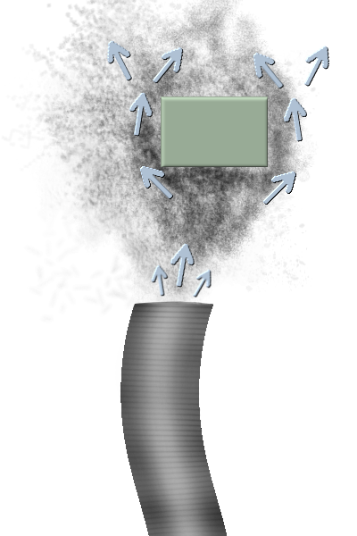
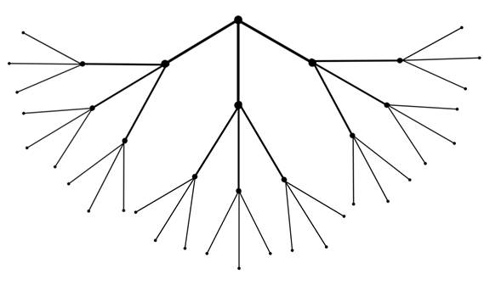
Goal
Working Inverse Kinematics Hierarchy
Smoke Particles
Collision using:
  Spheres
  AABBs (Axis Aligned Bounding Box)
  OBBs (Oriented Bounding Box)
  Maybe more (i.e. Concave and or Convex Intersection)

Slide 3
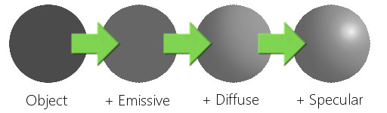
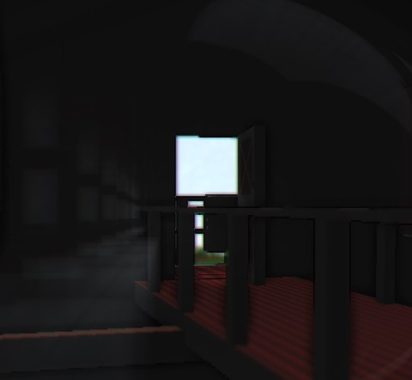
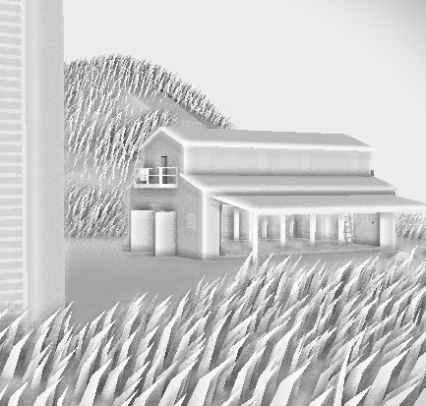
Goal
Post-processing Effects:
  Lighting
  SSAO
  Motion Blur
  Lens Flare

Slide 4
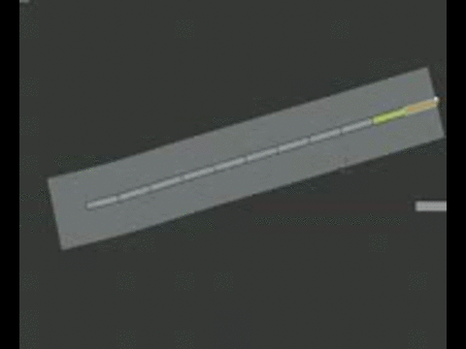
Inspiration
Blender (3D) and Spriter (2D)
  Quick and easy creation of animations for animators

Slide 5
Core Physics-based Ideas
Inverse Kinematics self collision detection
Smoke particles collision with other objects
Physics-based Animation features
Hierarchy of 3D objects animated using Inverse Kinematics

Slide 6
Possible Enhancements
Animate a model using it’s bone structure and Inverse Kinematics

